Slide 1
Search and Recursion
CS221 – 2/23/09

Slide 2
List Search Algorithms
Linear Search: Simple search through unsorted data. Time complexity = O(n)
Binary Search: Fast search through sorted data. Time complexity = O(log n)

Slide 3
How to Choose?
Linear search is optimal for
Unsorted data
Small data sets
Data sets that will change often between searches
Binary search is optimal for
Sorted data
Large data sets where performance is important
Data sets that are relatively stable

Slide 4
How to Implement Linear Search
Take a data-set to search and a key to search for
Iterate through the data set
Test each item to see if it equals your key
If it does, return true
If you exit the iteration without the item, return false

Slide 5
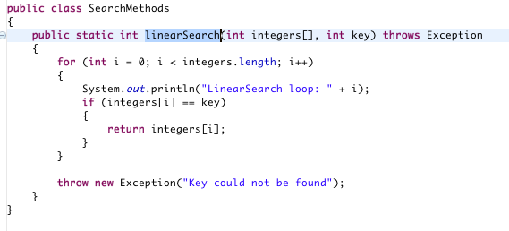
Integer Linear Search

Slide 6
Search Keys
Generally, search key and search result are not the same
Consider:
Search for a business by address
Search for a passenger by last name
Search for a bank account by social security #

Slide 7
Search Keys
How would the search change if the key is not the result?

Slide 8
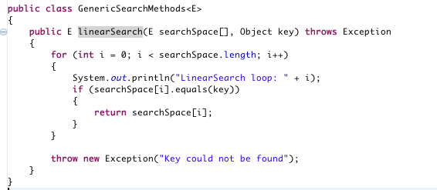
Generic Linear Search

Slide 9
How to Implement Binary Search
Take a sorted data-set to search and a key to search for
Start at the mid-point and see if that’s the key
If not, see if you need to search above or below the mid-point
Pick halfway point above or below and test again
Repeat until you can no longer cut the remaining set in half

Slide 10
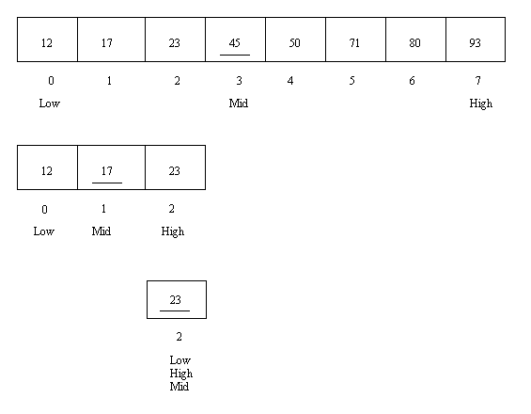
Binary Search

Slide 11
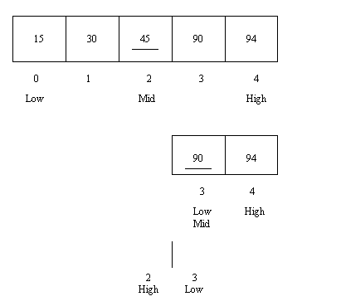
Binary Search

Slide 12
How to Implement Binary Search
Given a sorted array and a key
First = start of list
Mid = middle of list
Last = end of list
if array[mid] == key
Return key
If mid > key
Last = mid - 1
If mid < key
First = mid + 1
Mid = (first + last)/2
Continue until first > last
If the key isn’t found, throw an exception

Slide 13
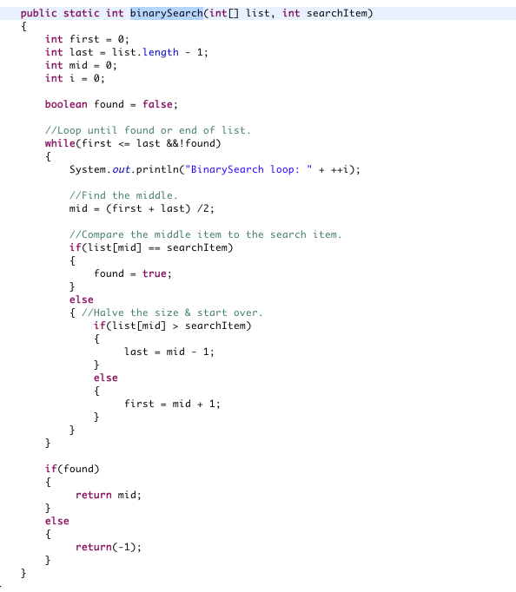
Integer Binary Search

Slide 14
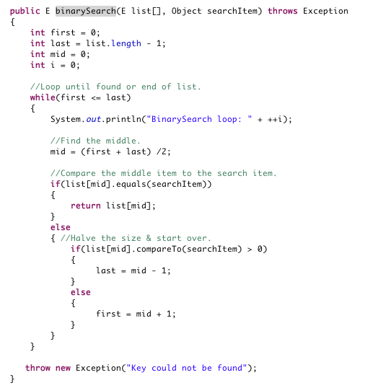
Generic Binary Search

